Slide 1
A catalyst for change: Edinburgh’s new approach to Induction
EFYE, June 2014
Jenni Murray and Abby Shovlin
University of Edinburgh

Slide 2
Session Aims
Introduction to Edinburgh’s new Induction Team and our aims and over-arching strategy
Reflection activity one: Characteristics of a good Induction
Sharing Edinburgh best practice
Spotlight on Academic Induction
Reflection activity two: Review and reflect on current Induction practice in your school/programme (reflective pathways tool)
Take away ‘can dos’

Slide 3
Edinburgh’s New Induction Team
Two Induction Coordinators: Jenni Murray and Kristin Hunger
One Academic Induction Coordinator: Abby Shovlin
Part of Edinburgh Student Experience Project: to understand, develop and enrich the student experience at Edinburgh
Induction model: (i)holistic, based on Whittaker’s (2008) 4 spheres of induction: administrative, academic, personal and social and geographic
(ii) longitudinal and student-centred

Slide 4
Edinburgh’s New Induction Team
Challenges
(academic) buy in for a new team and a new approach
Large devolved, silo based, research institution
Resources, budget, timing, staffing and resistance to change
Our approach to coordination:
Participatory (staff and students), cross-institution, partnership based, evidence based (quantitative and qualitative), iterative (framework writing consultations), celebratory (Gearing Up)

Slide 5
Edinburgh’s New Induction Team Round Table Approach
Academic
e.g. Personal Tutor
Support e.g. Student Support Officers
Central Units
e.g. Student Recruitment and Admissions
EUSA
Information Services e.g. library
Administrative
e.g. Matriculation Team
Student

Slide 6
Reflection Activity One
Induction/Orientation/Transition : what is it and what does it look like?
3 words to describe a good induction:

Slide 7
STUDENT EXPERIENCE PROJECT
Student Surveys Unit, Student Communications, Impact and Evaluation, Peer Support, Web Team, Applicant Experience, PCIM and more…
STRATEGY GROUP
UoE, 3 Colleges: 22 Schools
INDUCTION TEAM
IAD
EUSA
INDUCTION COORDINATION GROUP
INDUCTION SUBGROUPS
INTERNATIONAL SUBGROUP

Slide 8
Evidence gathering and dissemination
New Student Surveys
ESES (Edinburgh Student Experience Survey)
Learner Journeys: Through Your Eyes
Focus groups
Building forums for sharing and gathering feedback
Staff surveys
EDINBURGH INDUCTION FRAMEWORK

Slide 9
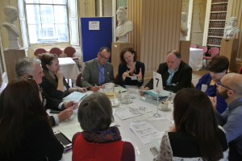
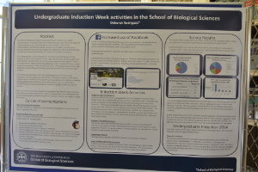
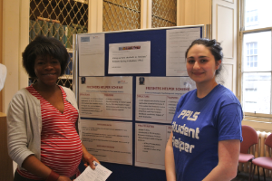
Staff Engagement: Gearing up for Induction

Slide 10
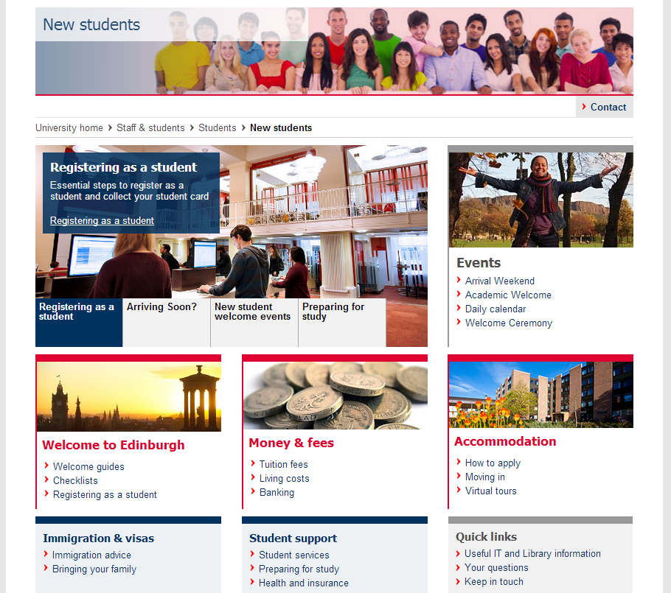

Slide 11
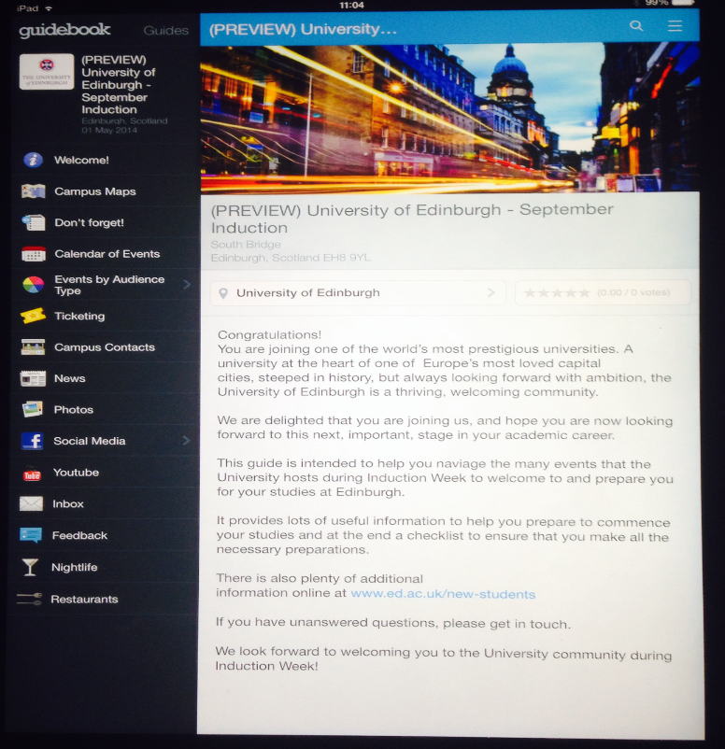
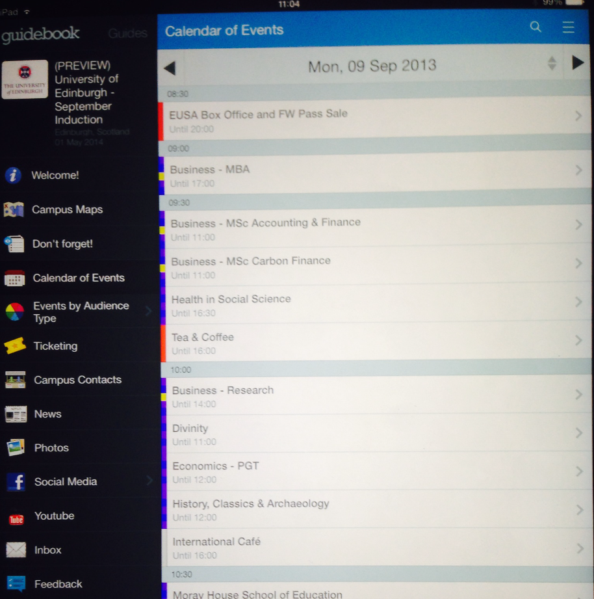
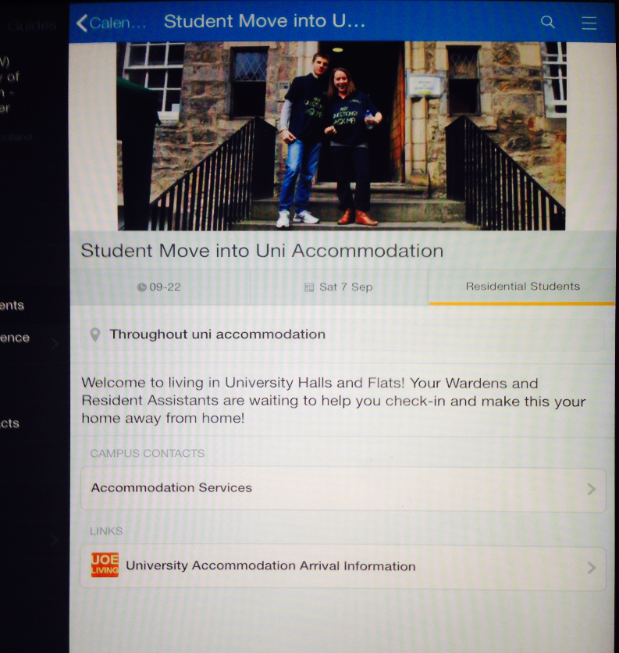

Slide 12
New Approaches
Extended January Induction
PGR Cohort Inductions
Extended Transition Programme for students with Aspergers
School pilots

Slide 13
Spotlight on Academic Induction Aims
Pre-arrival & induction as a golden opportunity
To pro-actively:
Tackle ‘gap’ between expectations of HE and reality
Engage students
Set ground rules
Build strong independent learner identities
Foster sense of belonging
Facilitate peer bonding

Slide 14
Activity Based Induction Theory
Reduce ‘information overload’¹ as transition should be viewed “not so much as a time for giving students information, but [as] rather focus[ing] on developing their capacity to engage” ²
Reduce time spent as a ‘passive’ learner ‘absorbing’ information³
Build pre-arrival and Induction programmes that allow students to sample and become familiar with learning activities ⁴
Foster student engagement/commitment by involving alumni/ recent graduates/ current students in Induction activities
“So, if I’m told something I can forget. If I’m taught something I can remember, it but if I’m involved in something then I can understand it. Would be what I would say” (P8, ‘Through Your Eyes’)
1.Edwards, 2011, Harvey & Drew 2006
2. Thomas, 2012
3. University of Bradford New Student Induction Guide
4. ibid

Slide 15
Enhanced Academic Induction Edinburgh best practice examples
EAI
Divinity pilot
Small group subject specific activity based induction
Student Panel
Childhood Practice
Study skills consultation with currents students
Custom made Academic Induction for new students
Linked up with College (direct entrants)
Health in Social Science
New UG programme
Pre arrival reading
Welcome Talk +
Maths
Consultation to build community in UG degrees and proactively tackle transition issues when studying maths at uni vs. school
Work with SLO to design Welcome Talk + with maths challenge

Slide 16
Reflect and review Reflective pathways model for Induction planning
Closed
Information transmission
Institution centred
Before ‘real’ learning begins
Passive ‘participants’
Fixed, singular and finite
What we expect from students
Participation
Engagement
Motivation
Critical Thinking
Reflection
Originality
Progress and growth
Ownership and independence
Academic good conduct
Peer bonding/group work
Student
?
Existing Skills
?
Knowledge
?
Expectations
Open
Student centred
Open, extended and ongoing
Part of ‘real’ learning
Activity based
Two way dialogue
Space for identity formation and clear path for growth

Slide 17
Thank you for taking part in this workshop.
Please do get in touch with us via: induction@ed.ac.uk if you have any further questions.

